Slide 1
Unit I
Engineering ethics – A focus of attention

Slide 2





What is Science and Engineering Ethics?
By definition (from Oxford Dictionary)
Ethic – System of moral principles, rule of conduct.
Ethics (used with a sing. verb) – Science of morals.
Study in ethics can be found in different contexts
Engineering ethics – the study of right conducts for engineering development
Animal ethics – the study of human concerns for animals
Research ethics – the study of the ethic for planning, conduct, and reporting of research

Slide 3
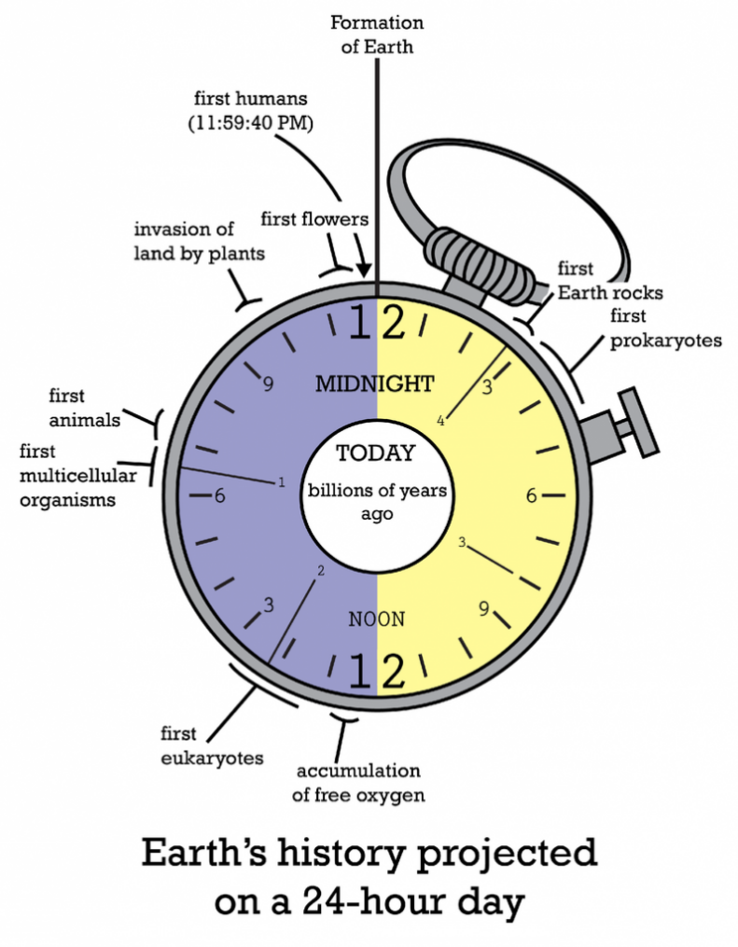


Why Science and Engineering Ethics is a focus of attention now?
Earth’s history projected on a 24-hour day
11:59:40 PM: First human
11:59:59 PM: Born of modern science (Eras of Galileo and Newton)
Industrial revolution
Era of information technology
Nuclear technology
Nano-technology
Quantum technology
:
All modern technologies we know were developed in the last second!
The planet earth is in an era of science and technology explosion
“History of Earth in a Day” by CK-12 is licensed under CC BY-NC 3.0

Slide 4
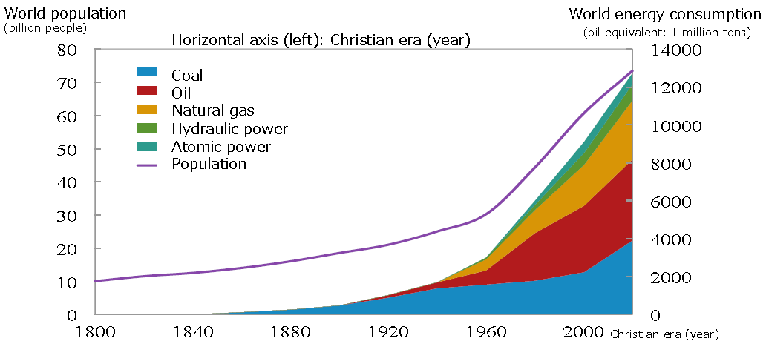

Why Science and Engineering Ethics is a focus of attention now?
While such rapid growth in science and technology promotes the well-being of mankind, it also leads to a severe consumption to the resource of our planet earth
Source: State of World Population, data from the Ministry of Economy, Trade and
Industry (Ministry of International Trade and Industry) and others.

Slide 5
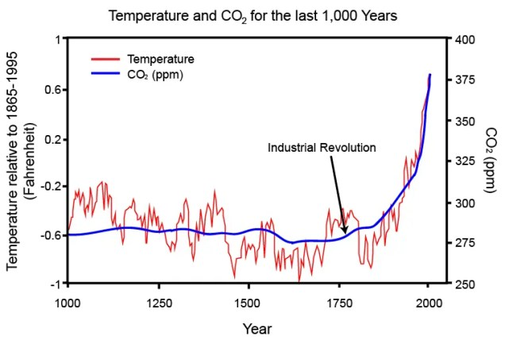
Why Science and Engineering Ethics is a focus of attention now?
It also introduces damages to the planet earth day after day
Source: https://timescavengers.blog/climate-change/co2-past-present-future/

Slide 6
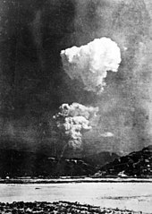
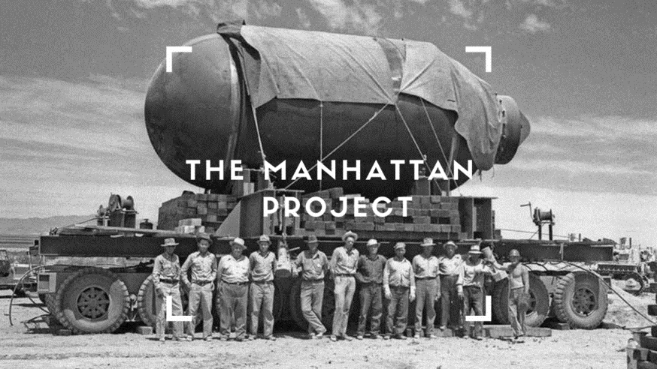
Why Science and Engineering Ethics is a focus of attention now?
A turning point of human history
6 August 1945
The U.S. detonated the first nuclear bomb over Hiroshima on 6 August 1945
The first time that the science and technologies developed by human beings can be used to obliterate mankind
Picture sources: https://www.linkedin.com/pulse/14-project-management-insights-from-oppenheimers-manhattan-kumar/
https://en.wikipedia.org/wiki/Atomic_bombings_of_Hiroshima_and_Nagasaki#cite_note-133

Slide 7


Why Science and Engineering Ethics is a focus of attention now?
Current science and technology are just like a race car, and scientists and engineers are its drivers
In the past 400 years, scientists and engineers only pushed the gas pedal to make the car run as fast as possible – some may even not turn the steering wheel!
It has never been so urgent to ask scientists and engineers to step on the brake a bit and ask ourselves
Are we doing the right thing?
Have we made the right choice?
Science and Engineering Ethics is a focus of attention nowadays, also the reason why we have this subject

Slide 8
What is Science and Engineering Ethics?
Science and Engineering Ethics
=
Rules for scientists and engineers???

Slide 9

A case …
Assume that you are the boss of a nuclear plant development company
Your company is asked to build a nuclear plant on the seashore of a city
The city has the regulation that nuclear plants should be built at least 3 meters above sea level to avoid being swamped by the waves caused by tsunamis, which happens occasionally
One day, the chief designer of the nuclear plant comes to you and says that he wants to build the nuclear plant 15 m above sea level
He found that in that area there was a tsunami 1000 years ago that caused waves 14 m high
However, such a design will significantly increase the cost of the nuclear plant and delay the construction work
Will you approve his proposal?

Slide 10




Analysis of the case
Accidents in nuclear plants can lead to severe damage to the city and the people around and need to be designed following extremely high safety standards
Even so, should we consider a once in a thousand years accident when making a design?
As building the plant at 3 m height has already met the expectation of the city (i.e., free from any legal responsibilities), why do we still need to consider a situation nobody expects?
If worst-case scenarios should be used when making a design, should we limit the speed of all cars on the road to less than 20 km/h, since obviously more people die due to car accidents than NPP accidents?
If you, as the boss, reject the proposal, would it be considered as violating engineering ethics?
Would it also be an ethical problem if an engineer overdesigns a system and leads to wastage in resources?

Slide 11
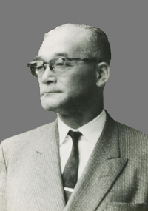
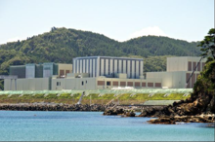
The real case
In 1968, Tohoku Electric Power prepared the construction plan for the Onagawa nuclear power plant (NPP)
As a member of the construction committee, Mr. Hirai Yanosuke (平井 弥之助) insisted on building the plant 15 m above sea level
He made reference to an earthquake in the area in 869 AD of magnitude 8.7 or more that generated waves at a similar level
He concluded that the generally expected height of waves of 3 m in the Onagawa region was severely underestimated
Most people at that time did not think there was such a need to build NPP at that height
Although the proposal would increase the construction cost and delay the completion date, the proposal was finally approved due to the persistence of Mr. Hirai Yanosuke
Hirai Yanosuke
Onagawa Nuclear Power Station in 2012
Picture source: Wikipedia https://en.wikipedia.org/wiki/Yanosuke_Hirai

Slide 12
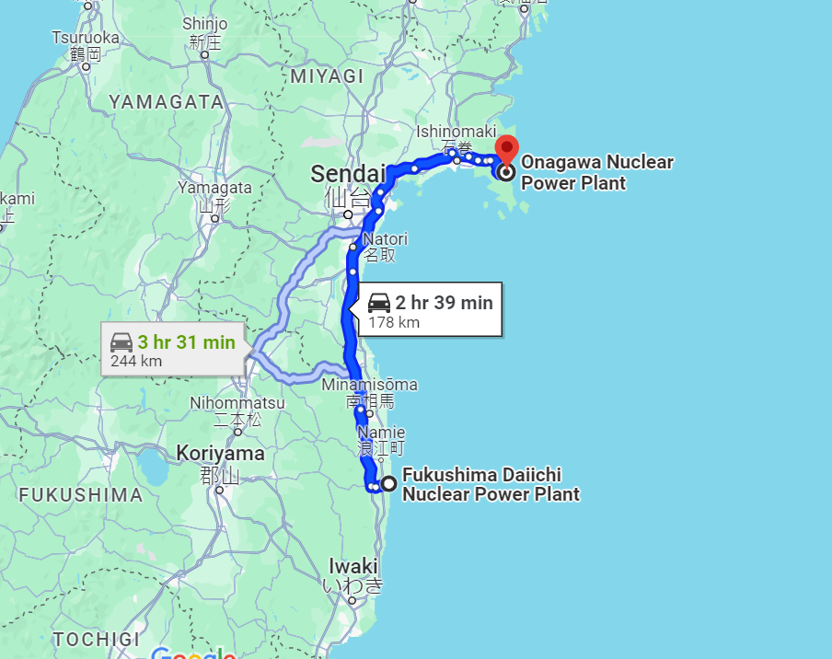
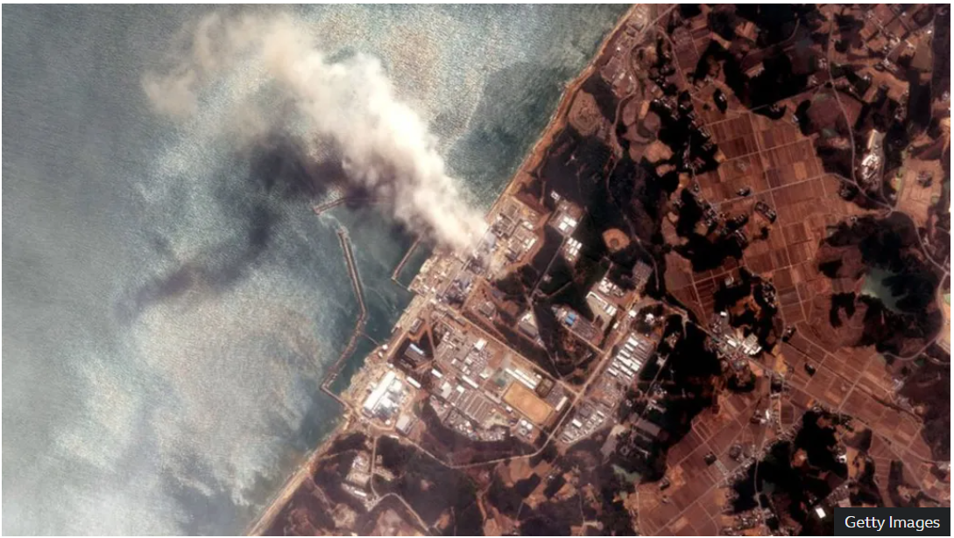


The real case
The effort paid off during the Tohoku earthquake and tsunami in March 2011 (magnitude 9.0)
In that event, nearby Fukushima Daiichi NPP experienced a meltdown of three of the plant’s six nuclear reactors due to the tsunami
In contrast, all three reactors of the Onagawa NPP which was closer to the epicenter of the earthquake and endured a stronger quake and the same tsunami level — survived virtually intact
Waves of 13.78 m high (12.78 m of wave height and 1 m of land subsidence) attacked the NPP but did not reach it by 1 m
From Google maps
Fukushima Daiichi NPP accident in March 2011
Source of picture: BBC https://www.bbc.com/news/world-asia-56252695

Slide 13
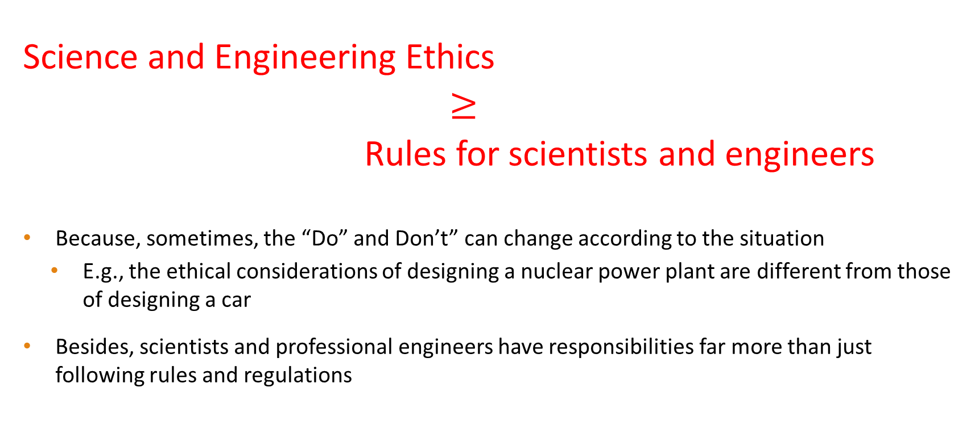
What is Science and Engineering Ethics?
Science and Engineering Ethics
$≥$
Rules for scientists and engineers
Because, sometimes, the “Do” and Don’t” can change according to the situation
E.g., the ethical considerations of designing a nuclear power plant are different from those of designing a car
Besides, scientists and professional engineers have responsibilities far more than just following rules and regulations

Slide 14


Preventive Ethics and Aspirational Ethics
Science and engineering ethics contain two parts:
Preventive ethics: stated in rules and is considered mandatory for all members of a profession
About following the rules and guidelines for preventing harm to the stakeholders and/or public
Aspirational ethics: allows the professional more discretion in determining what it involves and when and how it is implemented
More about making right decisions for the betterment of mankind

Slide 15


Preventive Ethics
Ethical guidelines – to prevent specific types of professional misconduct
Most professional organizations‘ codes of ethics are devoted to this type of regulation. For instance,
Hippocratic oath: Oath of medical doctors, the first known professional ethics code
Codes of Ethics of IEEE: http://www.ieee.org/portal/pages/iportals/aboutus/ethics/code.html
Preventive ethics are designed to protect the public from harm, either from technology itself or from the misconduct or lack of responsibility on the part of engineers themselves
The provisions of preventive ethics are mandatory, or even legally mandatory
Independent of the ideals or values of individual professionals
希波克拉底誓言

Slide 16
Aspirational Ethics
Professional ethics in its highest sense should involve something more than preventing harm to the public but also promoting social good
The social good of engineering is the promotion of the welfare and well-being of mankind
Clearly stated in professional organizations’ documents:
Institute of Electrical and Electronic Engineers (IEEE) – “…members of the IEEE recognize the importance of our technologies in affecting the quality of life throughout the world …”
American Society of Mechanical Engineers (ASME) – “… using their knowledge and skill for the enhancement of human welfare …”
As there are no rules carved in stone on how to promote the welfare of mankind, engineers always need to exercise their judgment in their action
Aspirational ethics – What kind of decision should we make and how should we act to promote the welfare of mankind?

Slide 17

How to make decision?
Engineers need to seek the right balance between many values when making decisions
Social Contribution
Advancement of expertise
Organizational development
Loyalty
Facts
Environment
Schedule
Information transparency Compliance
Integrity
Cost
Technological innovation
The welfare of mankind

Slide 18
How to make decision?
In making ethical decisions, enlarge your frame of reference and relativize your thoughts in terms of:
Time, place, and people
Always make references to the decisions made by other people at other places at different times
Would the boss of an NPP company be more willing to build an NPP at a higher height if he learns the story of the Onagawa NPP?
So, study through case studies is extremely important for learning Science and Engineering ethics
which is exactly the approach of this subject

Slide 19
Three levels of ethical studies
Discussions on ethics can be conducted at 3 different levels
Levels | Objectives
Macro | Relationship between science/technology and society
Meso | Organizational and institutional issues relating to science/ engineering practice and to scientists/engineers and organization
Micro | Behavior of Individuals (i.e., scientists and engineers)

Slide 20
Three levels of ethical studies
Discussions on ethics can be conducted at 3 different levels
Levels | Topics
Micro & Meso | Week 2: Ethics – The core value of engineering
Micro | Week 3 and 4: Making ethical decisions in engineering
Micro | Week 5 and 6: Research ethics and misconduct
Micro & Meso | Week 7 and 8: Responsible conduct of research
Micro & Meso | Week 9: Rights and responsibilities regarding intellectual property
Macro | Week 10, 11, and 12: Cyber ethics; ethical use of Generative AI

Slide 21
Summary
The rapid development of science and technology has led to many side effects that can adversely affect the survival of the human race
Scientists and engineers should think twice about the decisions they make – science and engineering ethics have become a focus of attention nowadays
Science and engineering ethics is more than just rules and regulations
Preventive ethics is about following rules and guidelines for preventing harm to the stakeholders and/or public
Aspirational ethics is about making the right choice to promote the welfare of mankind
Scientists and engineers should make references to the decisions made by other people at other places at different times when formulating their own decisions
Discussion on science and engineering ethics can be conducted at micro, meso, and macro levels

